Slide 1


Having Healthy Conversations
Notes:
DAN
SAUL TO ENTER INTO CHAT
Who has had an unhealthy conversation in the last 4-weeks? Y/N?
What specifically made it unhealthy?
What is the most important ingredient that makes a conversation healthier?

Slide 2
What will you gain from this session?
To raise awareness of how you and others behave in order to have healthy conversations.
Reduce conflict.
Draw out the best possible outcomes.
Notes:
DAN

Slide 3
Why healthy conversations matter
Grow trust when others see you tackling difficult situation
Build your confidence and that of your stakeholders
Develop your ability to help others achieve your potential
Notes:
VIK

Slide 4
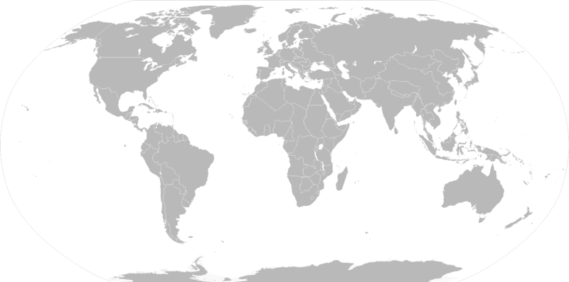

Slide 5
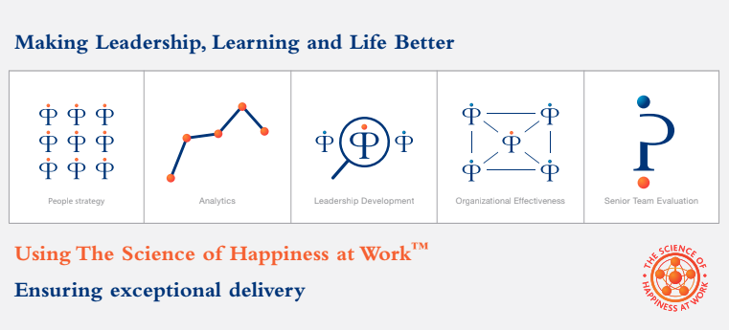
iOpener at a glance
Notes:
VIK

Slide 6
Keep:
Describes what someone did that worked well
Start:
Describes what he / she can do and what will work better
Notes:
DAN

Slide 7
Scenario 1
Notes:
DAN

Slide 8
Asking the right questions
Active Listening
Empathy
Notes:
DAN

Slide 9
Techniques
Notes:
DAN

Slide 10
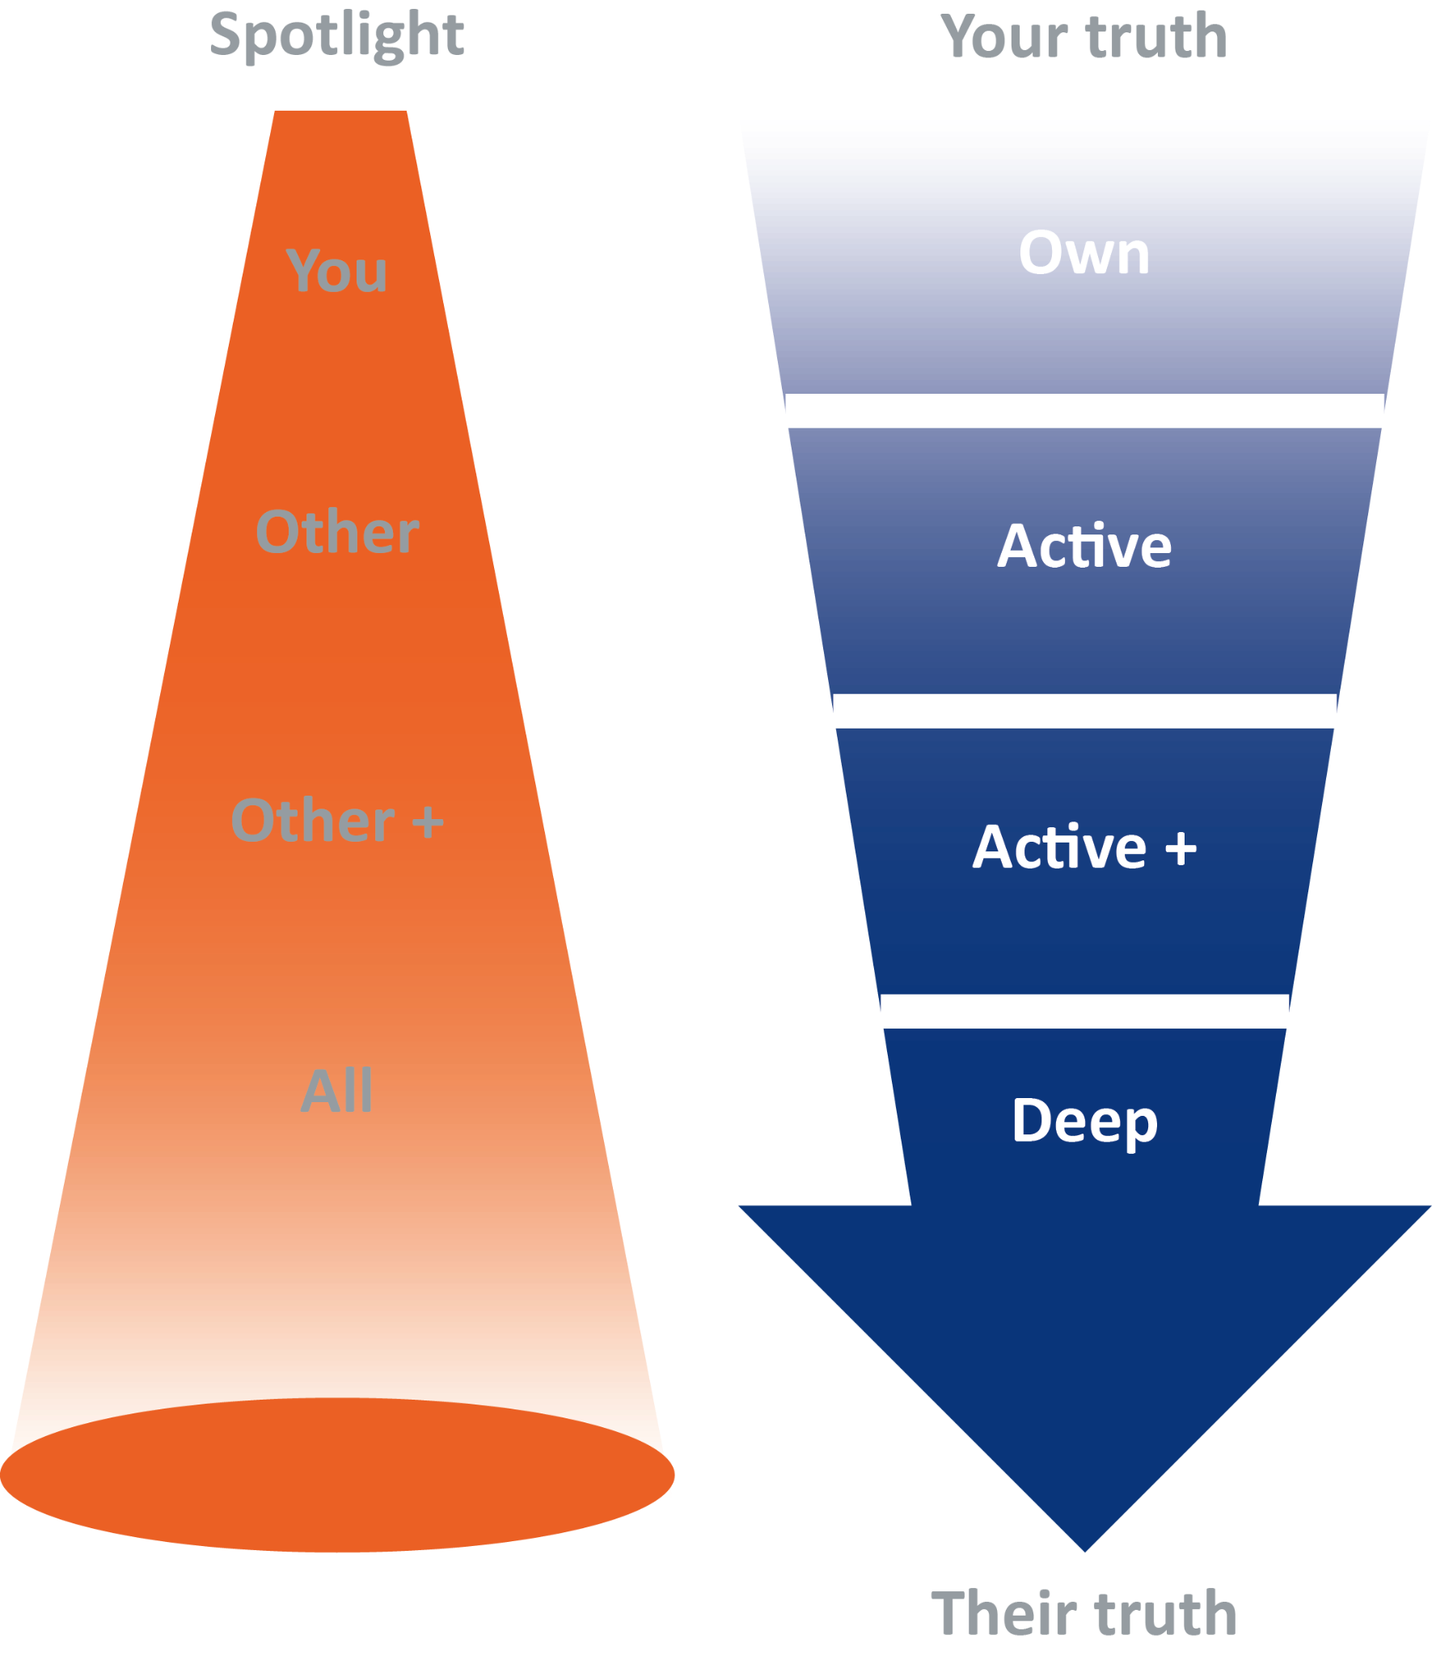
The 4 levels of attention
Notes:
DAN

Slide 11
My listening barriers
I find it difficult to listen to someone who is talking about...
I get irritated by speakers who...
As a listener, I switch off when...
When I’m listening to someone speaking, I find myself spending most of the time...
I am easily distracted when...

Slide 12
Listening techniques
Slow
Slow yourself down both physically and mentally.
Breathe
Breathe slower and deeper while focusing your thoughts on the other person
Tune
Tune into another’s internal voice by focusing your mental spotlight on them
Hold
Hold your silence: don’t interrupt the other person as they talk
Repeat
Summarize: you can only summarize well when you’ve been listening hard

Slide 13

Open questions
What?
How?
Who?
Where?
Why?
Tell me more about that?
Notes:
DAN

Slide 14
Closed questions
Can you?
Did you?
Have you?
Will you?
Notes:
DAN

Slide 15
Probing questions
Use probing questions to help you find out more detail or get to the root of something.
What specifically is the real issue at play here?
What exactly did you mean?
Reflective questions
Reflective questions ask your others to examine what they think about something, analyse it before they answer.
What do you want to have achieved by the end of this session?
What would you like to do differently?
Notes:
DAN

Slide 16
Hypothetical questions
A hypothetical question is really useful if you want to explore possibilities and approach something differently.
If you could get radically better at this, what would the implications be?
What if you were to go down the path. Where might it lead?
Scaling questions
Scaling questions help you gauge the feelings others have for any activity before, during or after it.
On a scale of 1 – 10, how much would you like to get a better outcome?
On a scale of 1 – 10, how keen are you to proceed?
Notes:
DAN

Slide 17
Neutral questions
If you really want to find out an individual’s point of view, you need to avoid making judgements or pointed comments about what they think, regardless of your opinion.
“What was the positive outcome you were hoping for?”
Do ask:
Do ask:
“I’m curious about why you all decided this was the best course of action?”
Don’t ask:
“What on earth led you all to do that?”
Don’t ask:
“In what way did you think it would help anyone?”
Notes:
DAN

Slide 18

Reviewing contracting skills
Contracting around a process is immensely important. Doing this ensures that the conversation:
Has boundaries, so can’t be hijacked or run off course
Has a clear focus which means less risk for both parties
Stays in control: both sides know what the conversation is about
Here are some useful contracting phrases:
I want to talk about… over the next 15 minutes.
I’d like to agree with you that we are going to have a conversation about… right now.
There’s an issue we need to address and I want to discuss it with you before it escalates.
Notes:
DAN

Slide 19
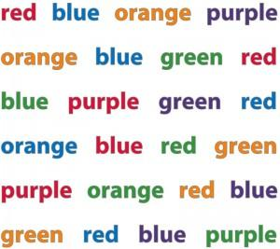
The Stroop Test : Say the colour you see
Notes:
DAN

Slide 20
Model

Slide 21
iDID model
Here’s a framework that applies equally to positive or negative conversations:
intention
Data
Impact
Difference
Giver
Control
Receiver
Notes:
VIK – 5 mins

Slide 22
Setting Intent
Ask yourself “what is the outcome I want for:
Me
Receiver
Both of us”
Ensure your intention is future-focused and aims to strengthen performance
Example
“I would like to share my view on how you can strengthen your sales performance in Q4.
This will increase your influence across the team that I know you really care about.
And for the whole team to achieve this year’s business development plan”
Notes:
VIK

Slide 23

Providing Data
Use facts
Describe what you saw and heard
Don’t focus on the attitude or something the receiver can’t change
Own the facts – unless this is positive feedback

Slide 24
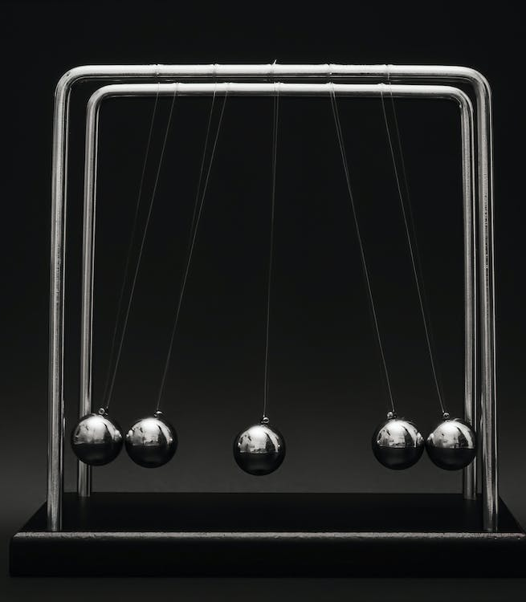
Explore the Impact
What is the positive or negative result for the receiver, client, team and also yourself?
Include the impact on feelings
Link to what’s most important to the receiver to increase the likelihood of change

Slide 25

Agree the Difference
How does the receiver want to move forwards?
What support is needed by the receiver?
What happens next?

Slide 26
Further example
intention: “I would like to share my view on how you can strengthen your sales performance in Q4. This will increase your influence across the team that I know you really care about. And for the whole team to achieve this year’s business development plan”
Data: “You have missed targets for the last 9-months for both new and existing clients. And I would really like to know how you see the situation….
Impact: “What impact is this having on our reputation across EMEA and beyond? I know this is something you care about…
Difference: “What sectors should we focus on for the next quarter?”

Slide 27
Scenario 2
Notes:
DAN

Slide 28
Polls
Notes:
SAUL

Slide 29
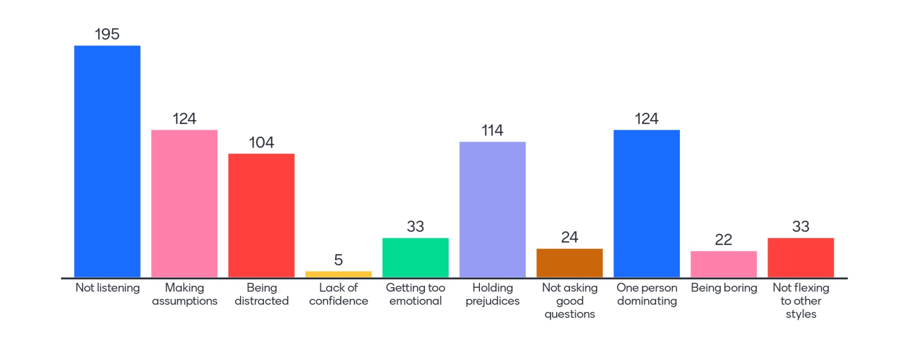
What are the top 3 things that make a conversation unhealthy or challenging?
Not listening
One person dominating
Making assumption
Holding prejudices

Slide 30
Having Healthy Conversations
Notes:
DAN
SAUL TO ENTER INTO CHAT
Who has had an unhealthy conversation in the last 4-weeks? Y/N?
What specifically made it unhealthy?
What is the most important ingredient that makes a conversation healthier?

Slide 32
Information filters
Moving towards/away from:
Moving away: you are motivated by the need to avoid unpleasant experiences.
Moving towards: you are motivated by achieving what attracts you - you “move towards” it.
Internal/external:
Internal: you like to decide what is right for you, without anyone telling you. You base your decisions on your own judgment.
External: you like to know what others say and think. You consider other’s views before reaching conclusions.

Slide 33
Information filters continued
Orientation in-time/through-time:
In-time: you live “in the moment. Because you get so immersed in the present moment you can lose sense of time. Planning ahead may be difficult for you
Through-time: It is easy for you to review, plan and organise. You don’t get overwhelmed by the here-and-now detail, but you can find it hard to “get into things because you are so future-oriented”
Preferred chunk size: small/large:
Small chunk: you are good at noticing, handling and remembering detail. You may find it difficult to see the whole picture
Large chunk: you are great at vision and planning. You may get impatient with the detail necessary to make your plans work

Slide 34
Developing Cultural Intelligence
To work effectively with different cultures:
Map – do research: Appreciate that different cultures operate differently
Bridge – be curious: Listen, ask questions and observe
Integrate – develop skills: Scrutinise your own thinking / assumptions.
Mindset – positive attitude: Be ready to learn Demonstrate behavioural agility & expand your response options.

Slide 35
Milton-Bennett Development Model of Cultural Sensitivity
ETHNO-RELATIVE
ETHNO-CENTRIC

Slide 36
Milton-Bennett Development Model of Cultural Sensitivity
Ethno-centric approach
ETHNO-RELATIVE
INTEGRATION
ADAPTATION
ACCEPTANCE
MINIMISATION
DEFENCE
DENIAL
Ethno-relative approach
ETHNO-CENTRIC

Slide 37
Milton-Bennett Development Model of Cultural Sensitivity
being interculturally competent
INTEGRATION
ADAPTATION
starting to act differently
ACCEPTANCE
starting to see differently
MINIMISATION
assuming that we’re all the same really
DEFENCE
thinking we’re right and they’re wrong
DENIAL
assuming they are the same as us

Slide 38
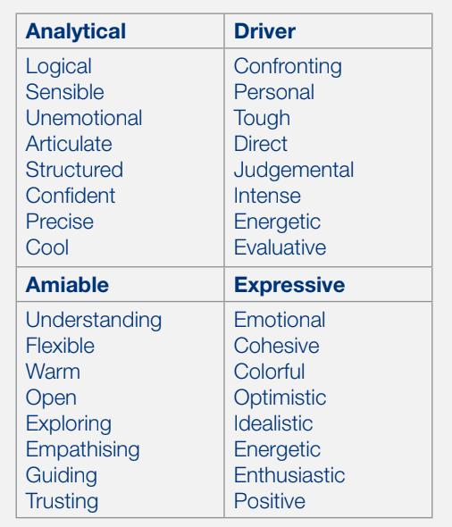
Influencing styles
Adapted from People Styles at Work, Bolton & Bolton

